Slide 1

Introducing ChatFlow: Real-Time, Anonymous Chat
ChatFlow enables secure, anonymous conversations instantly.
No registration or personal data needed.
Notes:
1

Slide 2

Key Features of ChatFlow
Anonymous Chat
No accounts or tracking, privacy guaranteed.
Real-Time Messaging
Instant message delivery with minimal delay.
Secure Data Handling
Focus on protecting user privacy at all times.
User-Friendly Interface
Easy and intuitive for all users to navigate.
Notes:
2

Slide 3
Tech Stack:
Robust Server Logic
Session Management
RESTful APIs
Reliable processing with SuperBase.
Handles sessions efficiently for scalability.
Seamless frontend-backend communication.
Notes:
3

Slide 4
Tech Stack: React Frontend & Database
Interactive Frontend
WebSocket Implementation
Database Support
React, TypeScript powers the responsive user interface.
Enables live updates and instant messaging.
MySQL/PostgreSQL handle data persistence and sessions.
Notes:
4

Slide 5

Real-Time Communication with WebSockets
Low-Latency Messaging
Messages delivered under 200ms under normal conditions.
Bi-Directional Communication
Instant feedback between client and server.
No Constant Polling
Reduces unnecessary server requests.
Improved User Experience
Smoother and responsive chat interactions.
Notes:
5

Slide 6
Ensuring Data Security and Privacy
Anonymous Sessions
Secure WebSocket Connections
Regular Security Audits
Privacy Standards Compliance
No personal data is stored or tracked.
Uses TLS encryption for data safety.
Frequent updates ensure compliance and safety.
Meets GDPR and industry requirements.
Notes:
6

Slide 7
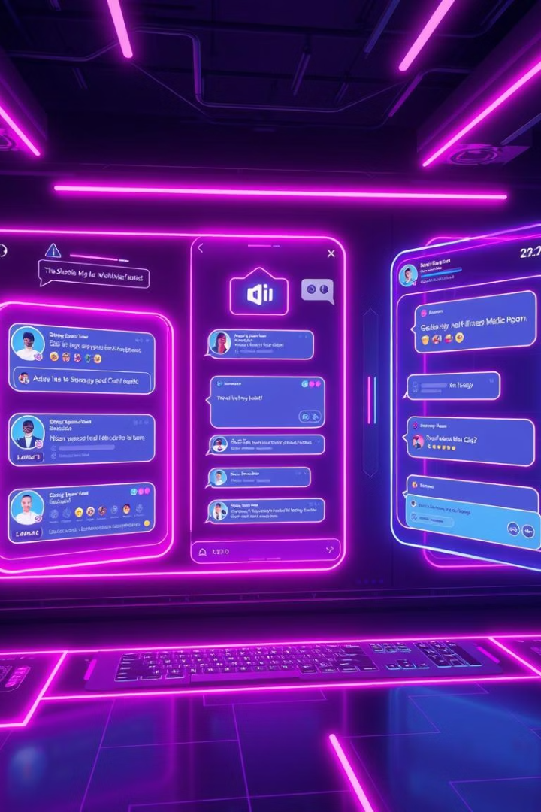





Future Applications and Potential
Encryption Integration
Boost security with advanced encryption protocols.
Multimedia Support
Enable images, audio, and video messaging.
Moderation Tools
Enhance community safety with smart controls.
Customizable Chat Rooms
Create tailored spaces for different groups.
Notes:
7

Slide 8

Conclusion: The Future of Anonymous Communication
Secure & Private
ChatFlow prioritizes user data protection.
Ongoing Enhancements
Continuous development drives new features.
Explore Possibilities
Unlock new ways to communicate anonymously.
Notes:
8

